Slide 1


SHREYA PANDEY
Modern Treasures
Data-Driven Insights into the Museum’s Art Collection

Slide 2

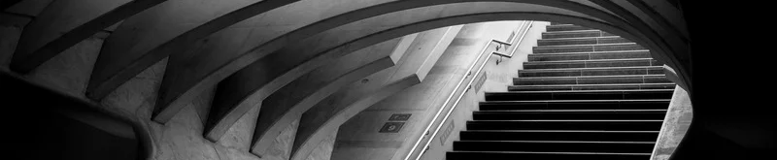
Contents
Project Summary | 3
Dataset Overview | 4
Data Transformation in SQL | 5
Dashboard Structure | 6
How Modern is the Collection? | 7
Artists Most Featured | 8
Collection by Classification | 9
Top Artists by Department | 10
Interactive Artist Profile | 11
Additional Insights and Conclusion | 13

Slide 3
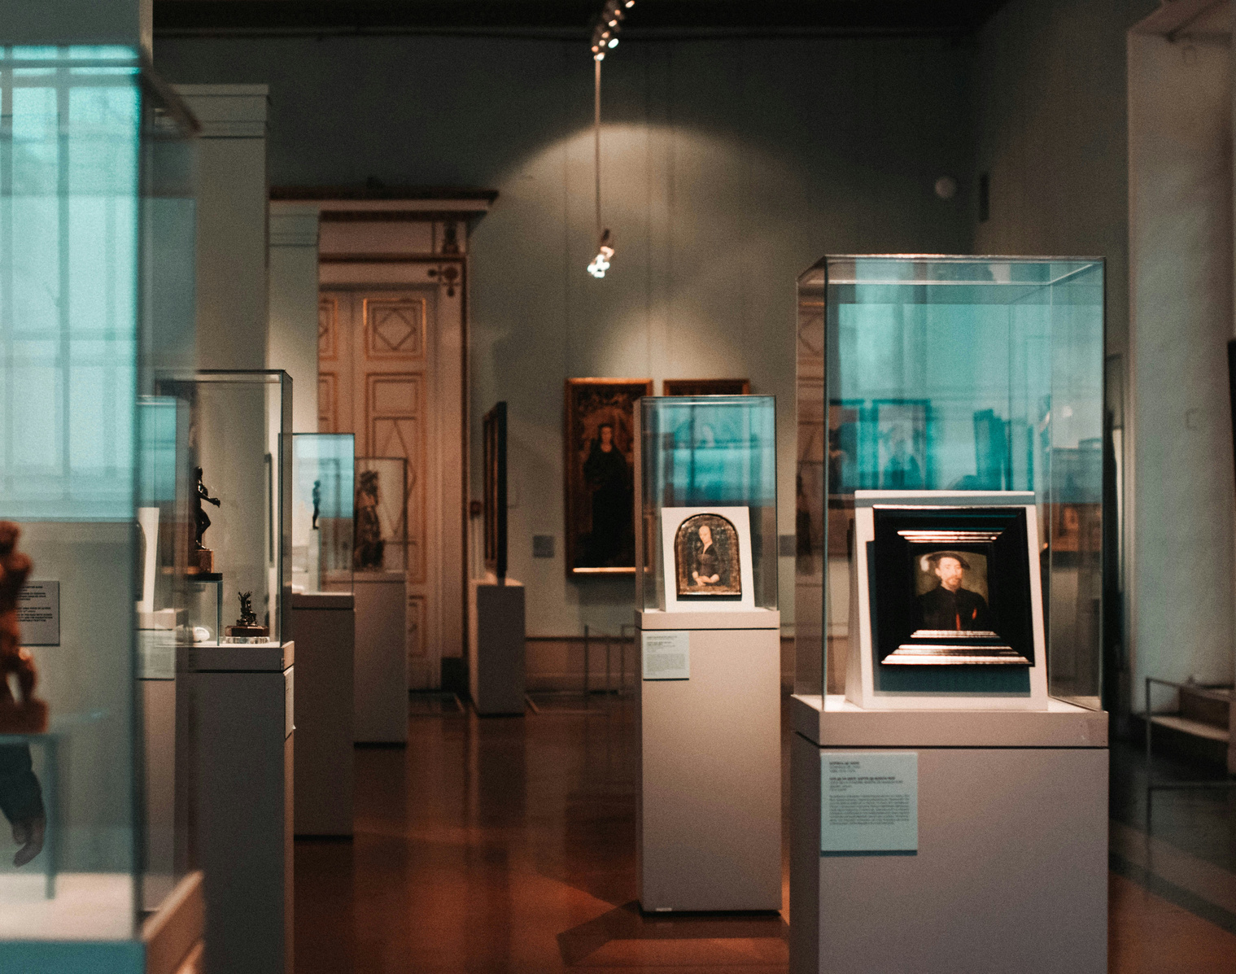
Dataset Overview
Constituent ID, Title, Artist, Medium, Dimensions
Gender, Nationality, Classification, Department
Date of Creation, Date Acquired

Slide 4

Trimmed
Data Transformation
in SQL
Standardized fields (Gender, Nationality, Medium)
Split
ConstituentID to normalize multi-artist entries
Extracted and Transformed
Year & Month fields from Date Acquired

Slide 5







Page 1 - Museum Overview
KPIs & Yearly Trends
Acquisition Timeline by Period
Classification & Nationality Analysis
Most Featured Artist
Dashboard Structure
Page 2 - Artists & Department Explorer
Poweri BI Dashboard Layout
Interactive Artist Profile
Top Artist per Department
Total Artworks by Year & Department

Slide 6

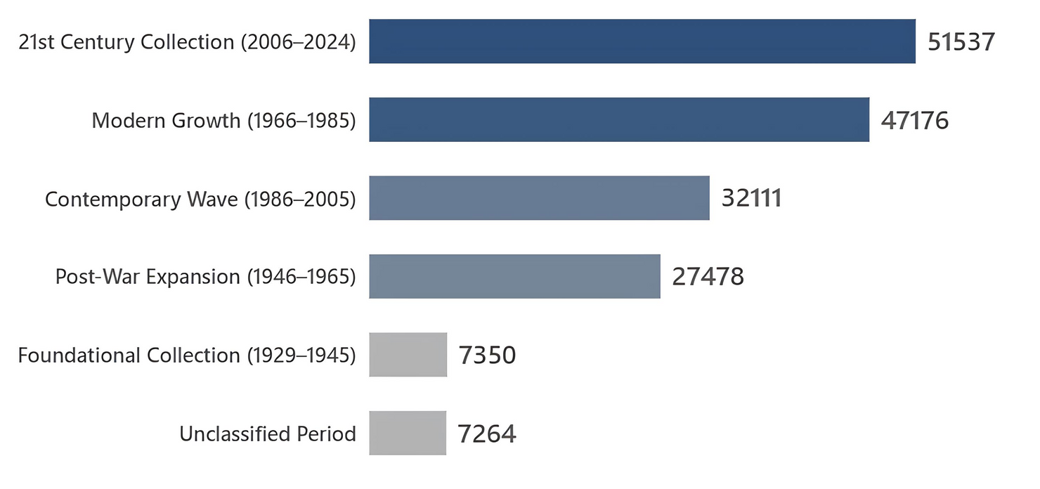
How Modern Is the Collection?
Artwork Acquisition Trends
Over 80% of the Artworks were acquired after 1965
Majority Artworks added in the 21st Century (2006-2024)
It shows a strong focus on Modern & Contemporary Artworks

Slide 7
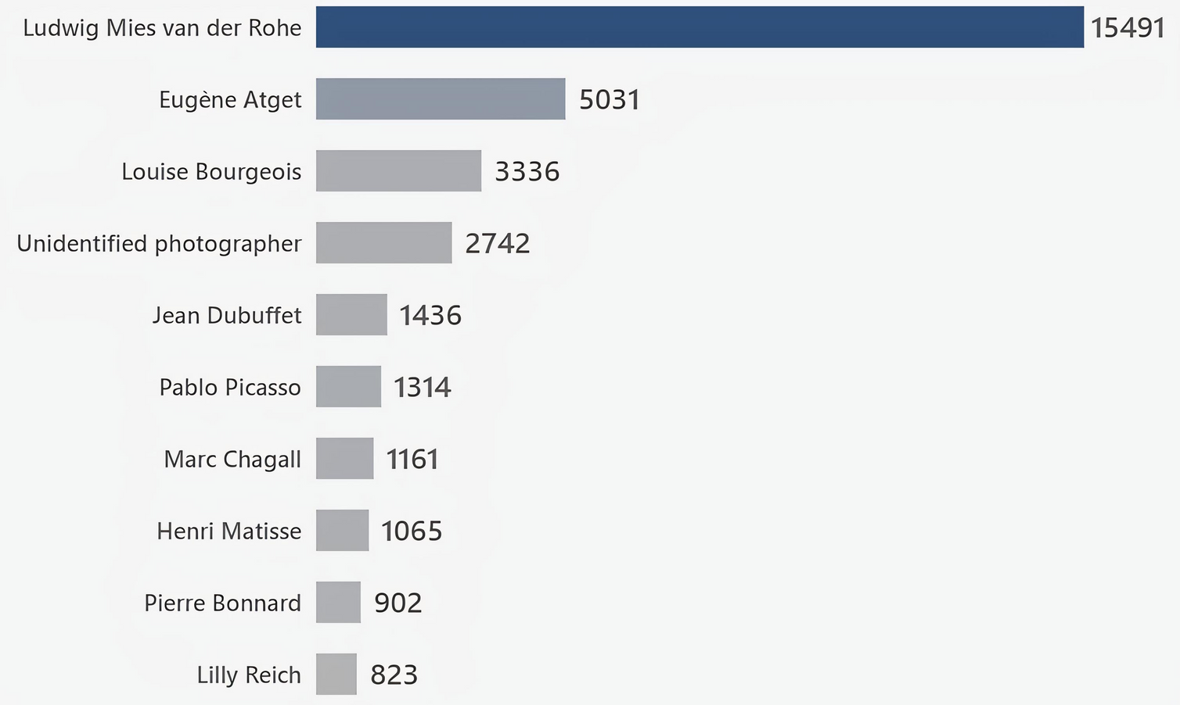
Artist Most Featured
Who Dominates the Collection?
Ludwig Mies van der Rohe: 15,000+ pieces
Eugene Atget leads in Photography
Picasso, Matisse, Chagall also featured prominently

Slide 8
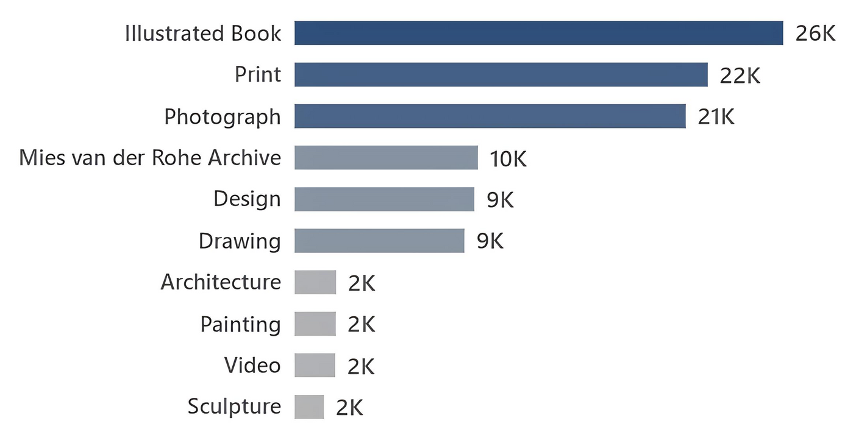
Collection by Classification
What types of artwork are most common?
Photographs, Prints, and Illustrated Books dominate
Strong focus on reproducible visual media
Paintings represent a smaller portion

Slide 9
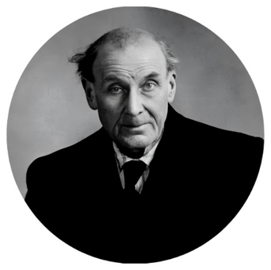


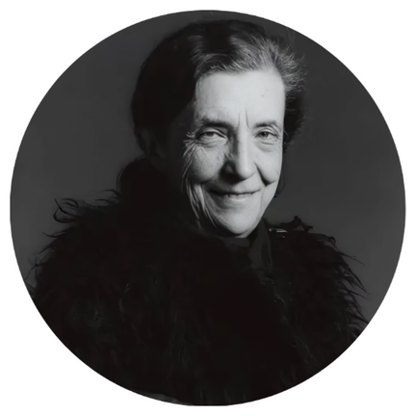

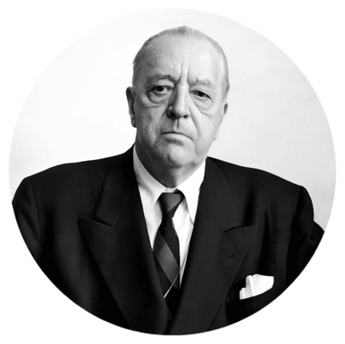

Eugene Atget
Jerry Lewis
Photography
Film
Top Artist by Department
Pablo Picasso
Louise Bourgeois
Painting & Sculpture
Drawings & Prints
Patterson Beckwith,
Alex Bag
Ludwig Mies van der Rohe
Curatorial Focus by Department
Media & Performance
Architecture & Design - Image Archive
George Maciunas
Ludwig Mies van der Rohe
Fluxus Collection
Architecture & Design

Slide 10
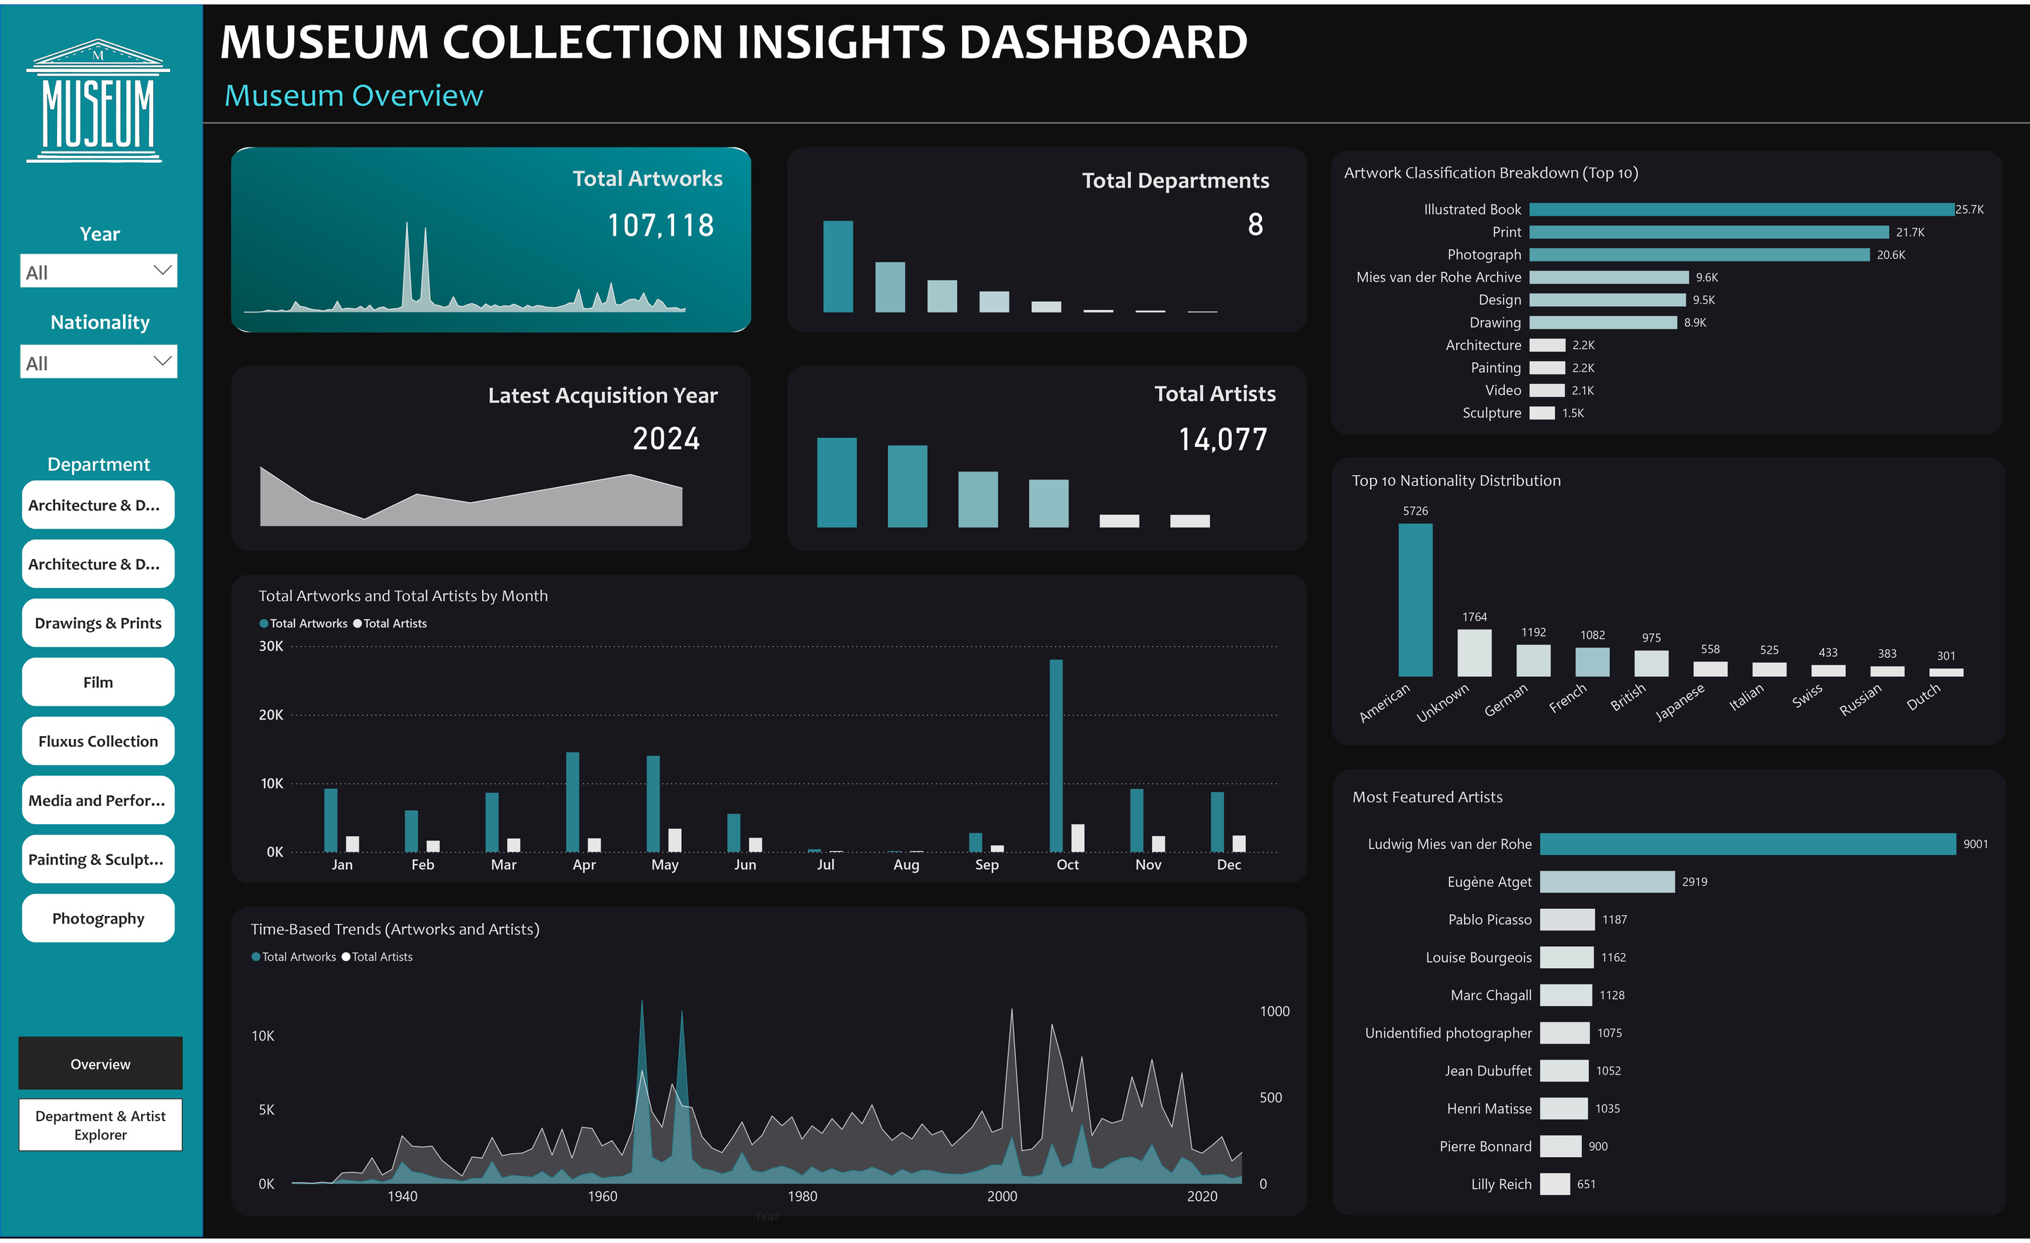

Slide 11
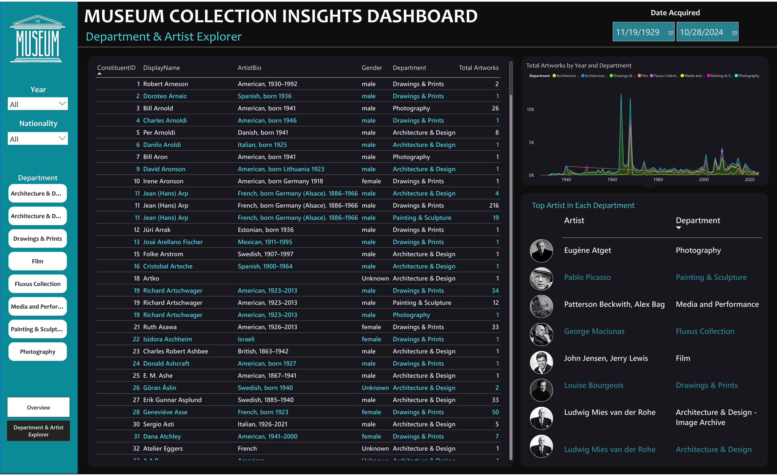

Slide 12



Technology & Tools
Powered By...
SQL Server
DAX in Power BI
Power BI
Data cleaning, joins, filtering
Dynamic measures (top artist, period logic)
Dashboard creation and interactivity

Slide 13
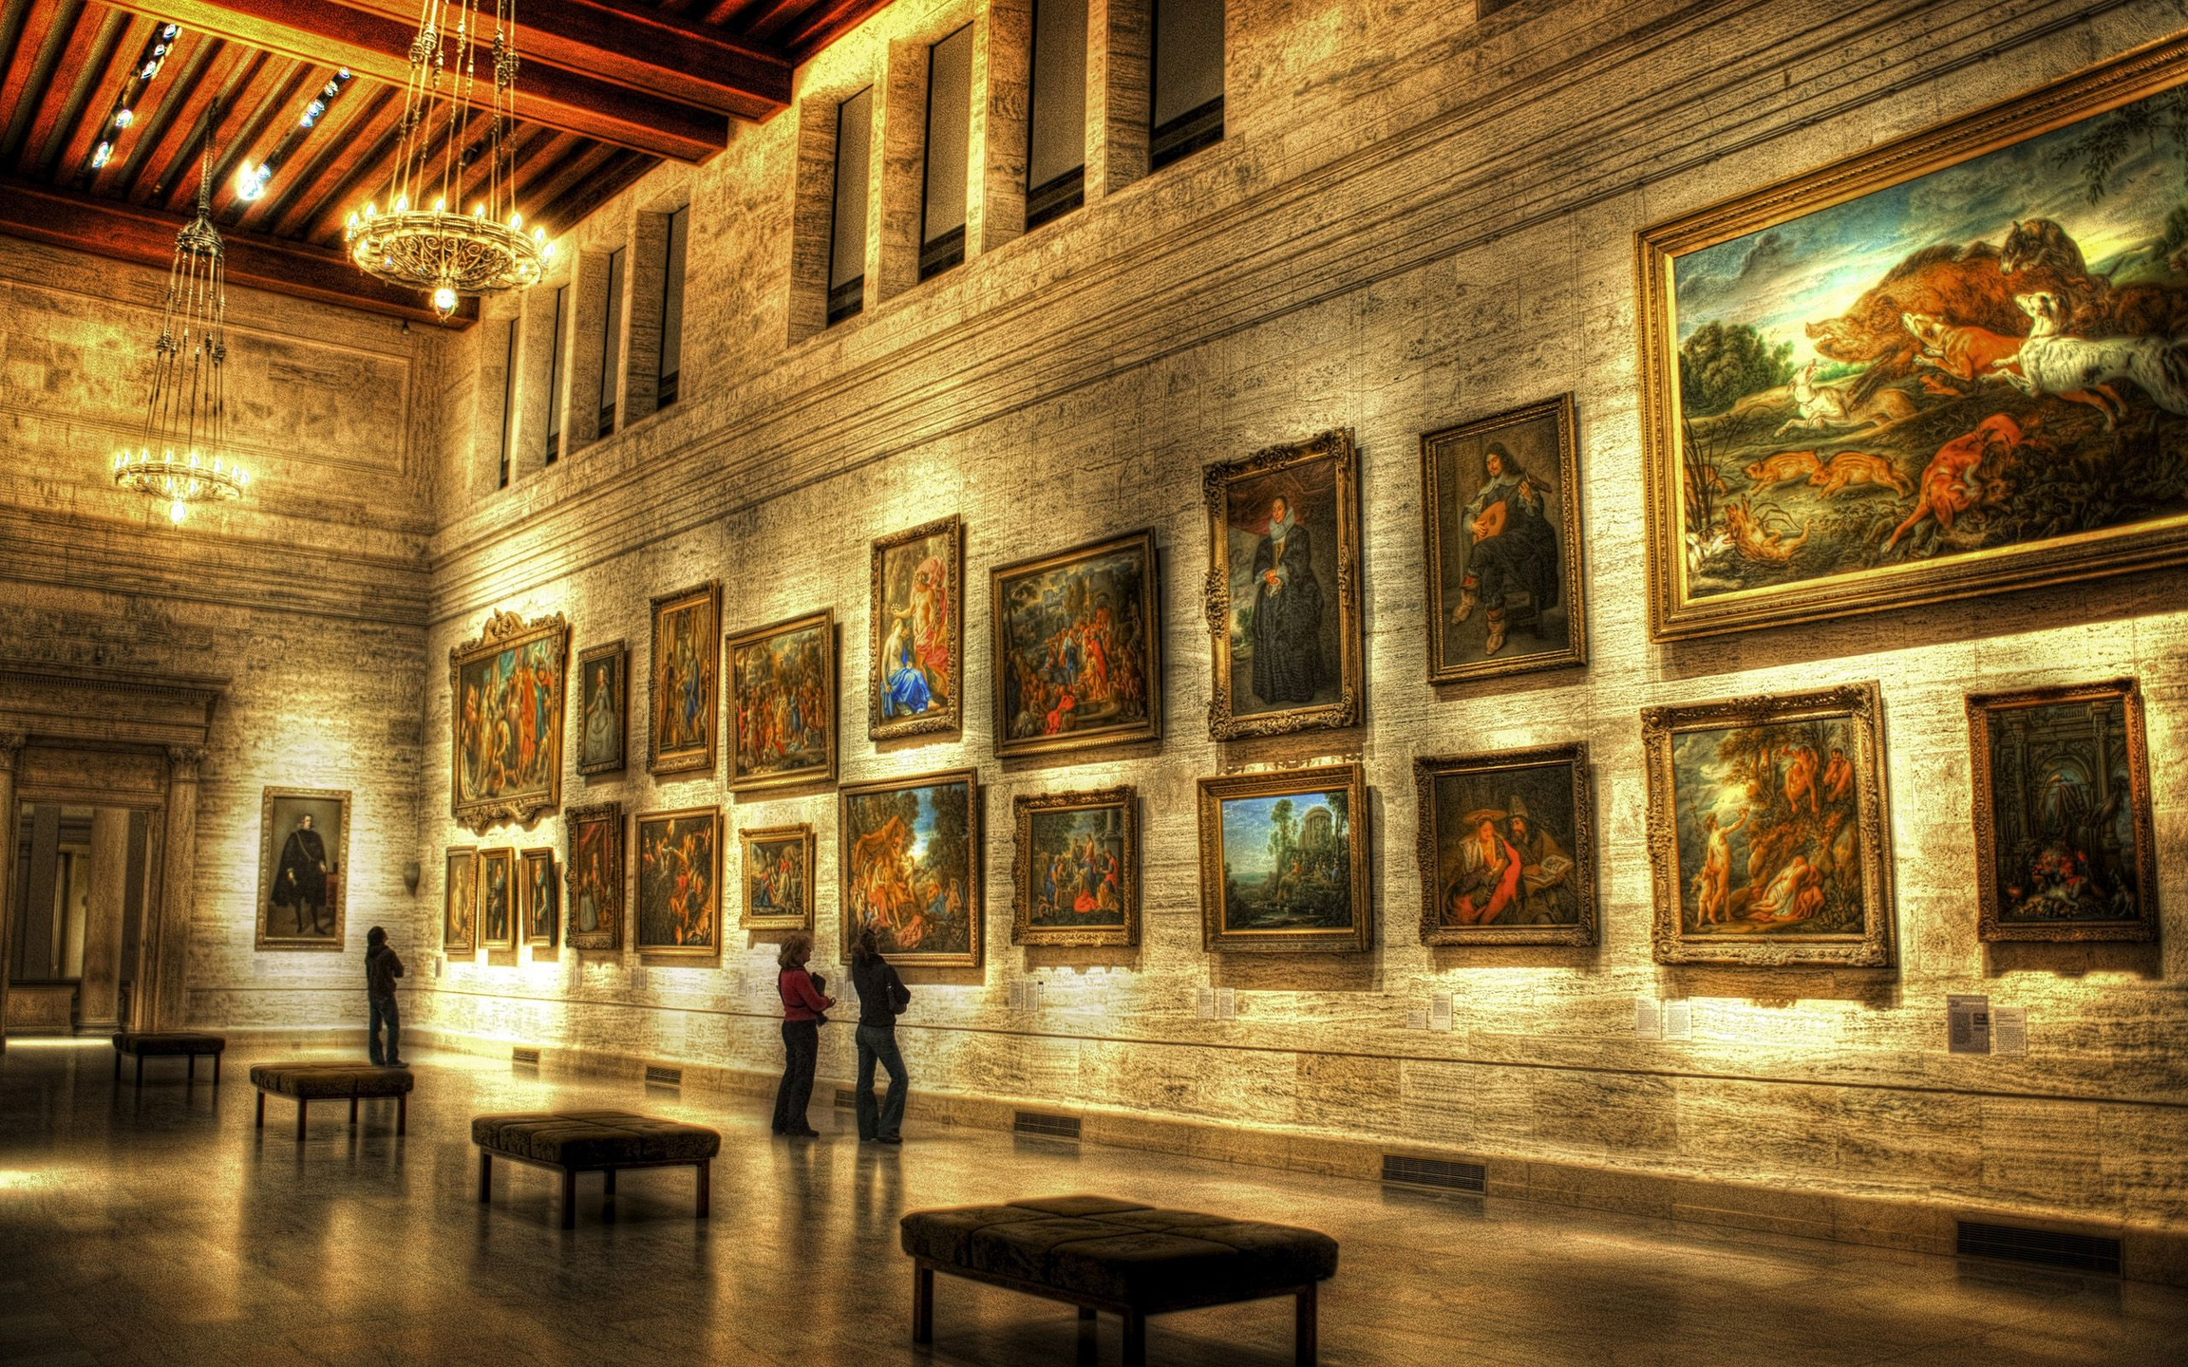
Conclusion
The Museum's collection is modern, diverse, and globally influenced, clearly focusing on 20th and 21st-century works.
Key insights into top artists, acquisition trends, and departmental focus offer curators, researchers, and art lovers valuable knowledge.
The interactive Power BI dashboard transforms raw data into a visual storytelling tool, enabling smarter decisions and richer engagement.

Slide 14

Thank
You

